Slide 1
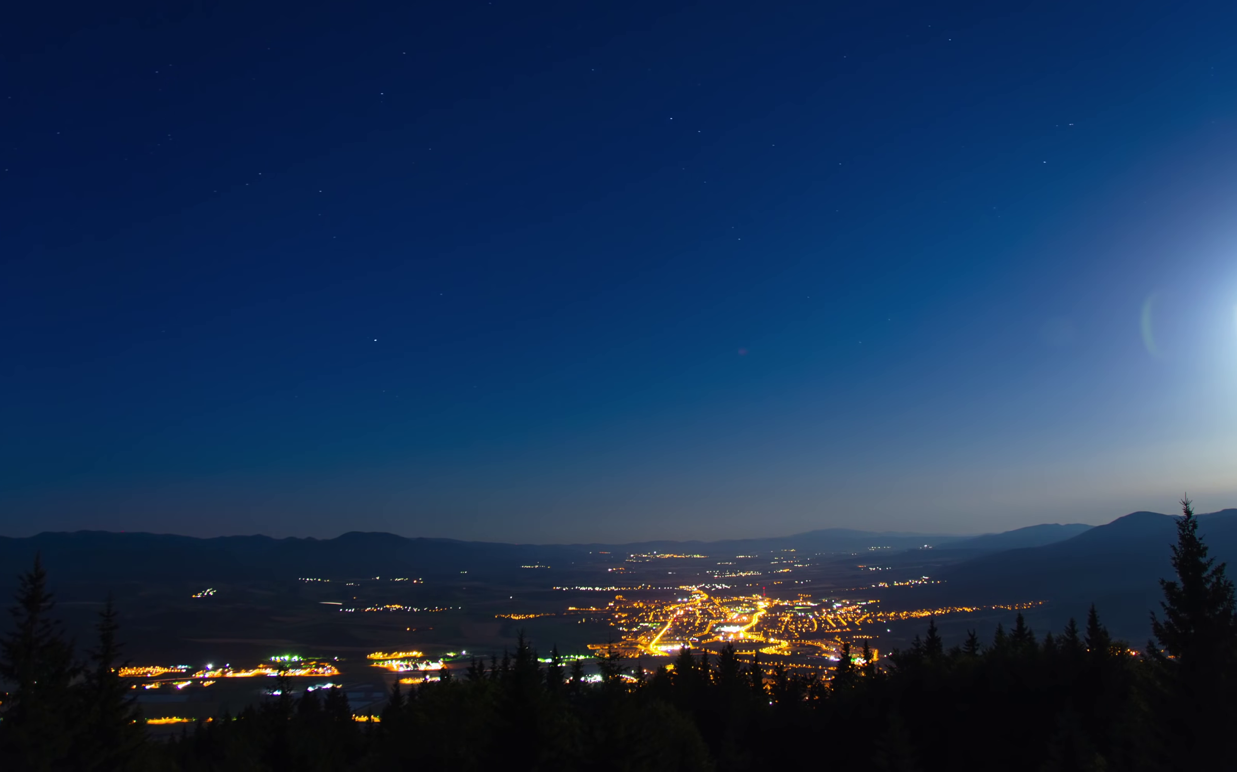
Photo-Realistic Background Generation
Ganiyu Ibraheem & Philipp Seybold
Advanced Computer Vision
Group 4

Slide 2
Overview
Introduction
Multimodal image-to-image translation
Demonstration & limitations
Related work
Implementation details
More applications

Slide 3
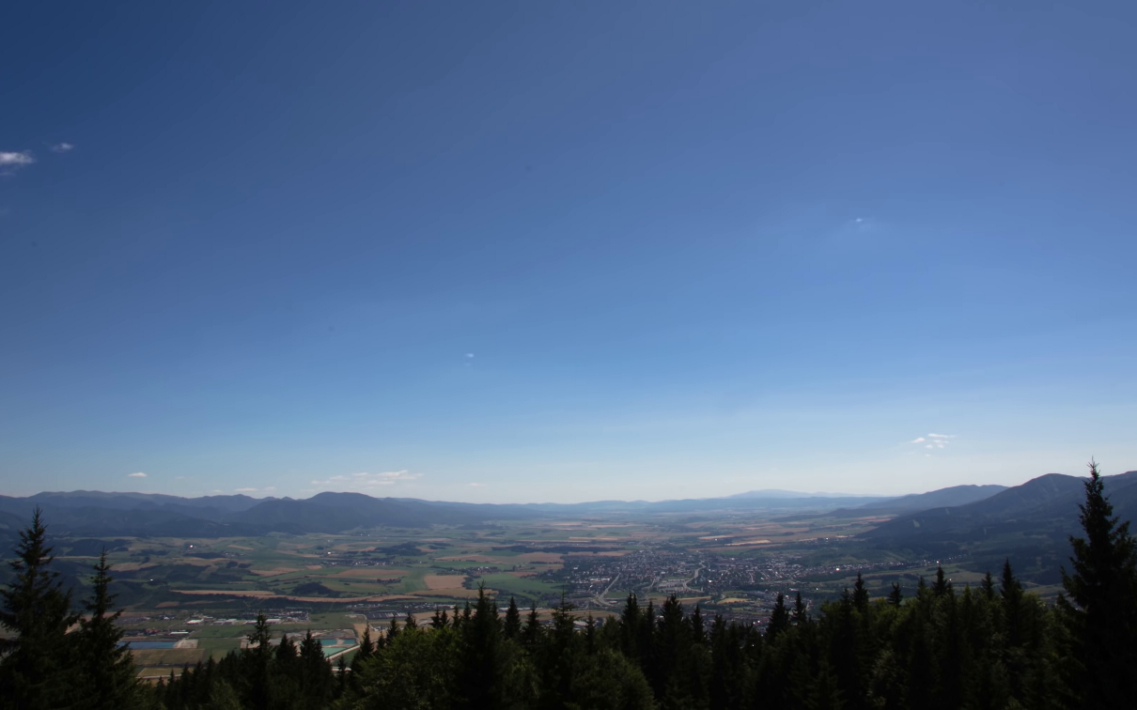

Introduction
Aim: Generate photorealistic backgrounds
Source: youtube.com

Slide 4


Introduction
Aim: Generate photorealistic backgrounds
Image-to-image translation, but:
We need a multimodal translation
?
?
?
?
?
Input
Different possible outcomes

Slide 5

Multimodal image-to-image translation
Solution: Generative adversarial networks (GANs)
Input
50 samples from our Model

Slide 6
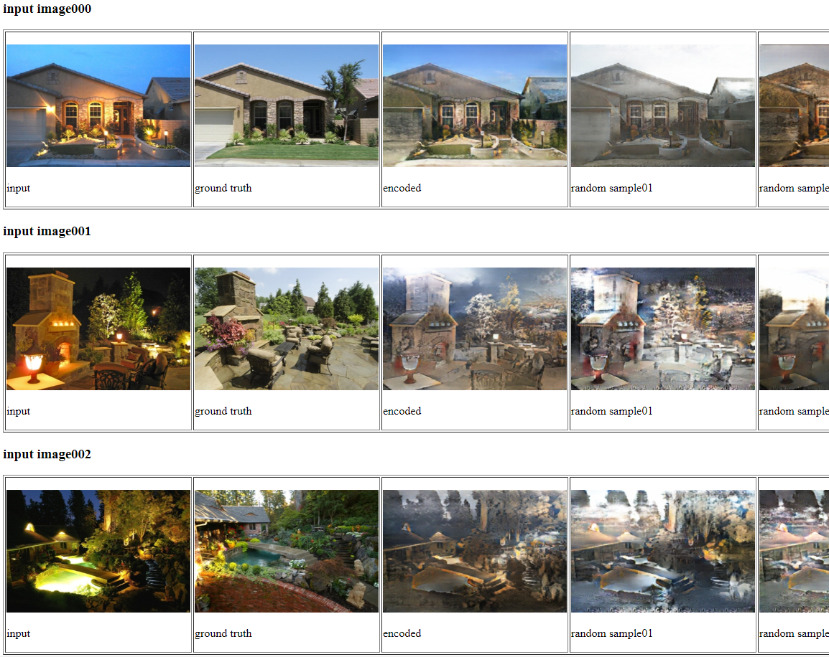
Demonstration

Slide 7
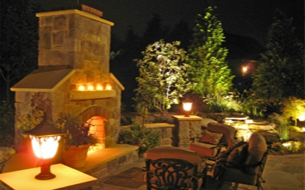
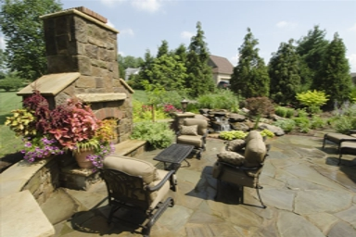
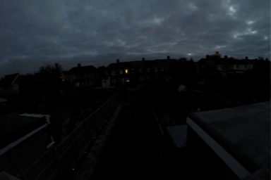
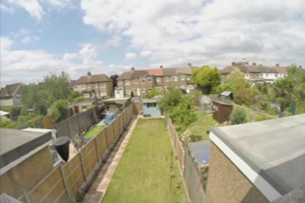
Limitations
Input
Ground truth

Slide 8
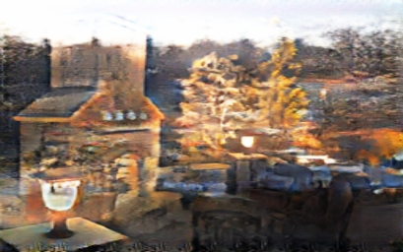
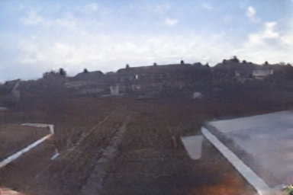
Limitations
Input
A random sample

Slide 9
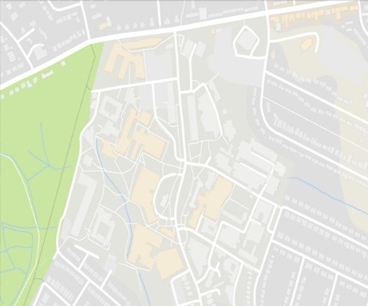
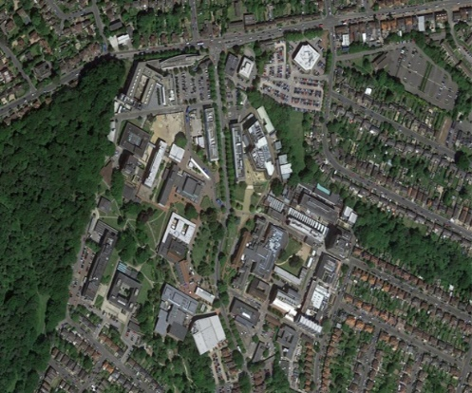
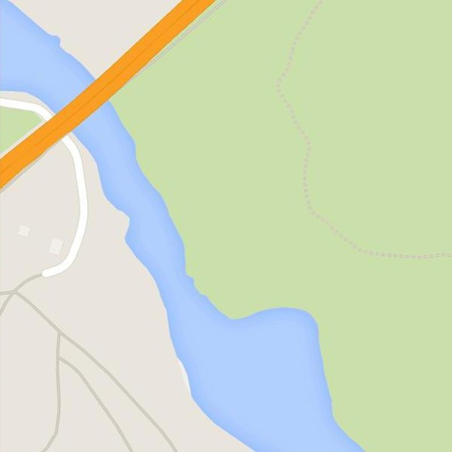
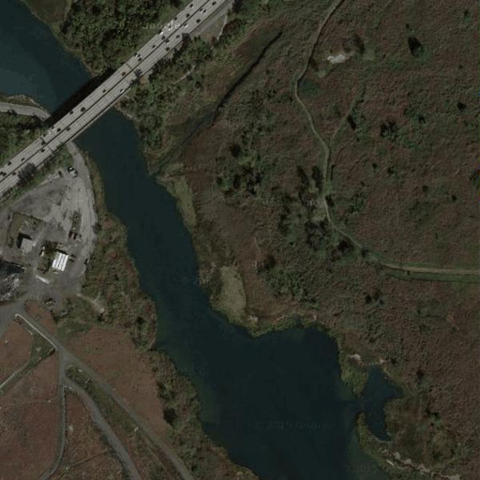
Demonstration
Input
Ground truth
Distribution of samples (total: 40)
Source: maps.google.com

Slide 10

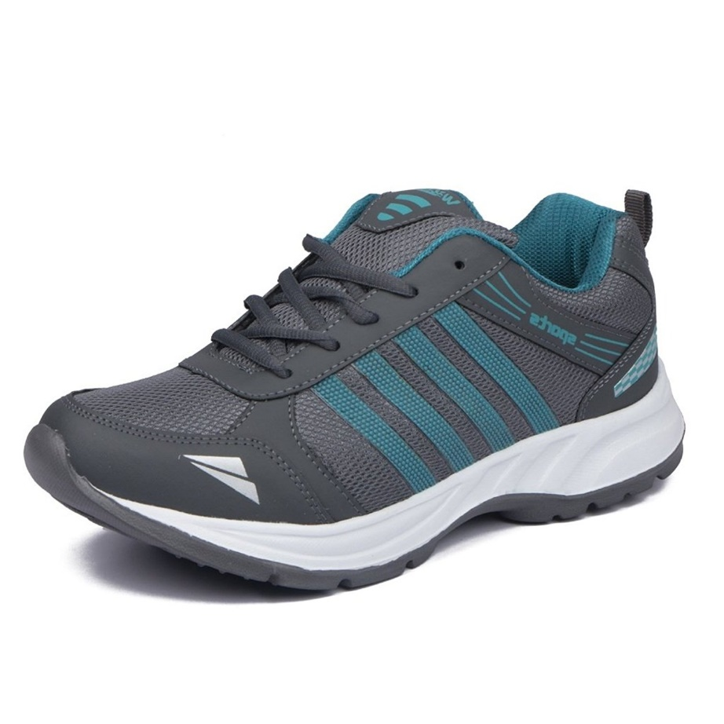
Demonstration
Input
Desired Output
Source : Amazon.com
Lets draw one!

Slide 11
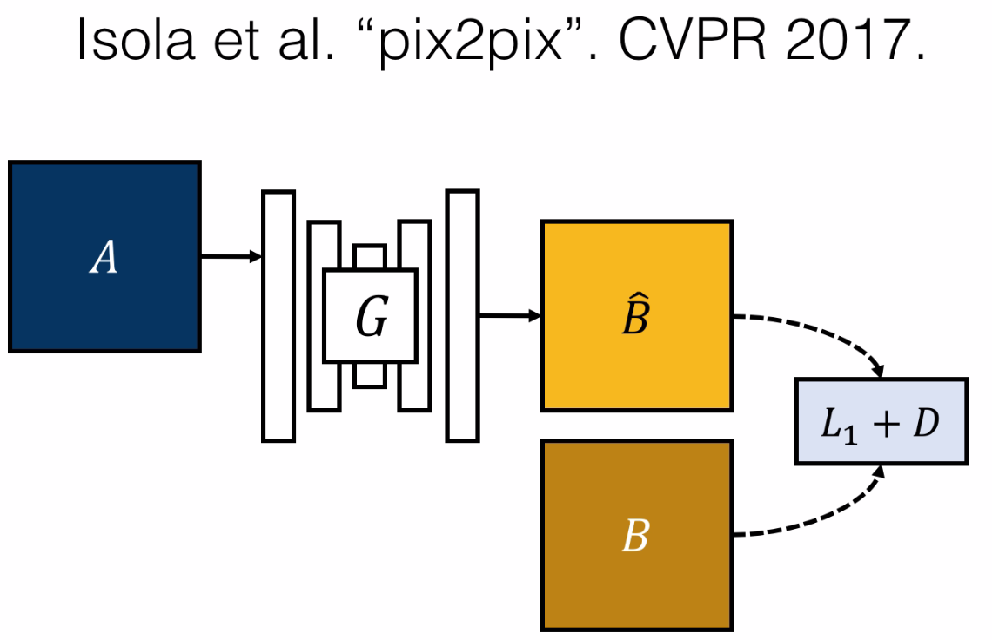
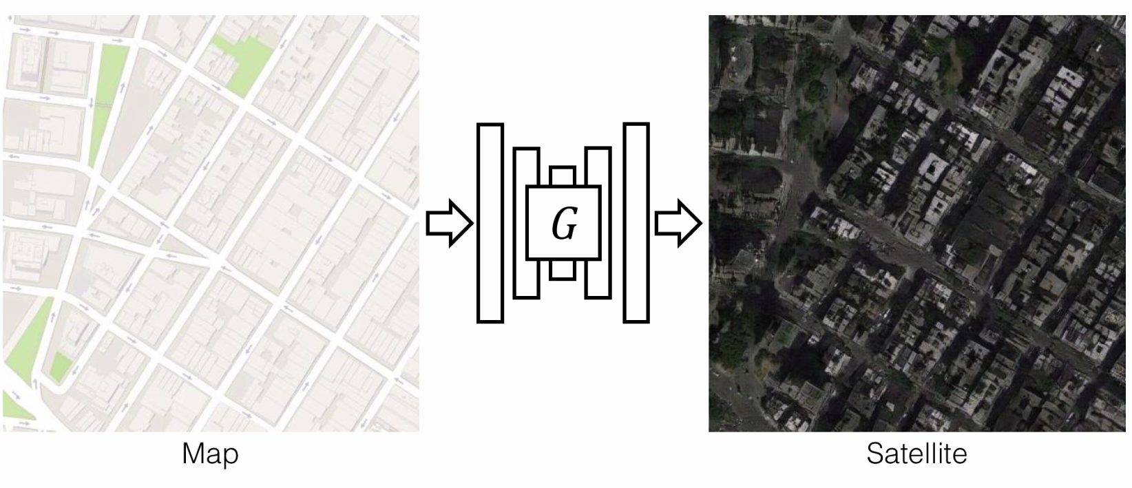
Related work
…

Slide 12
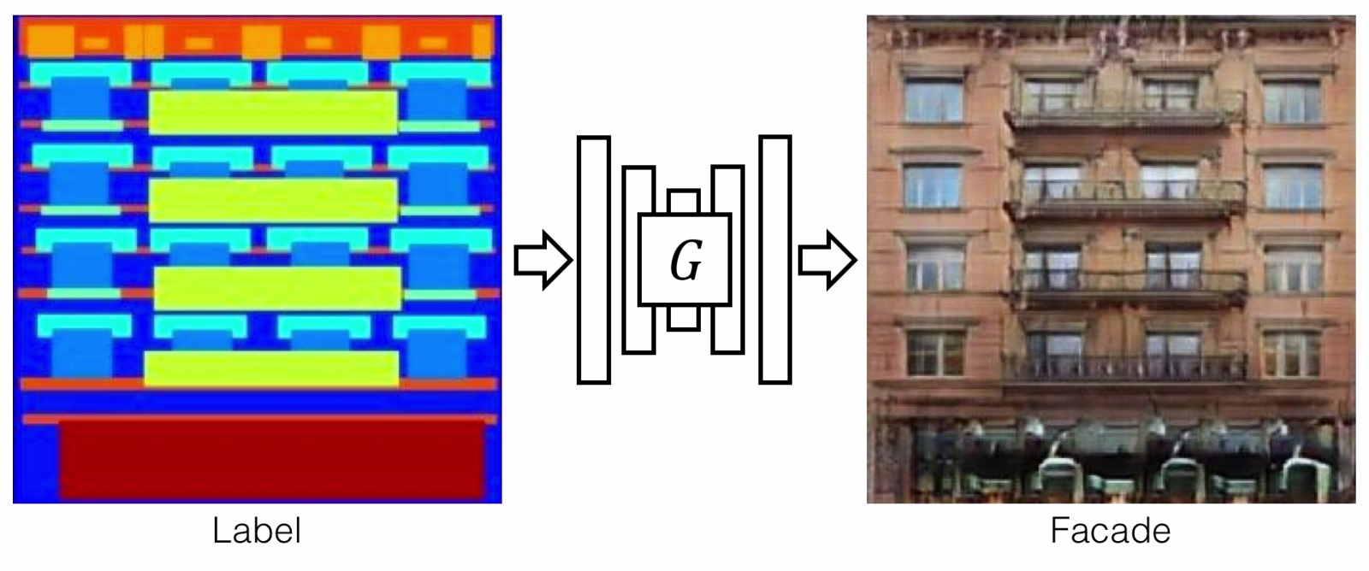
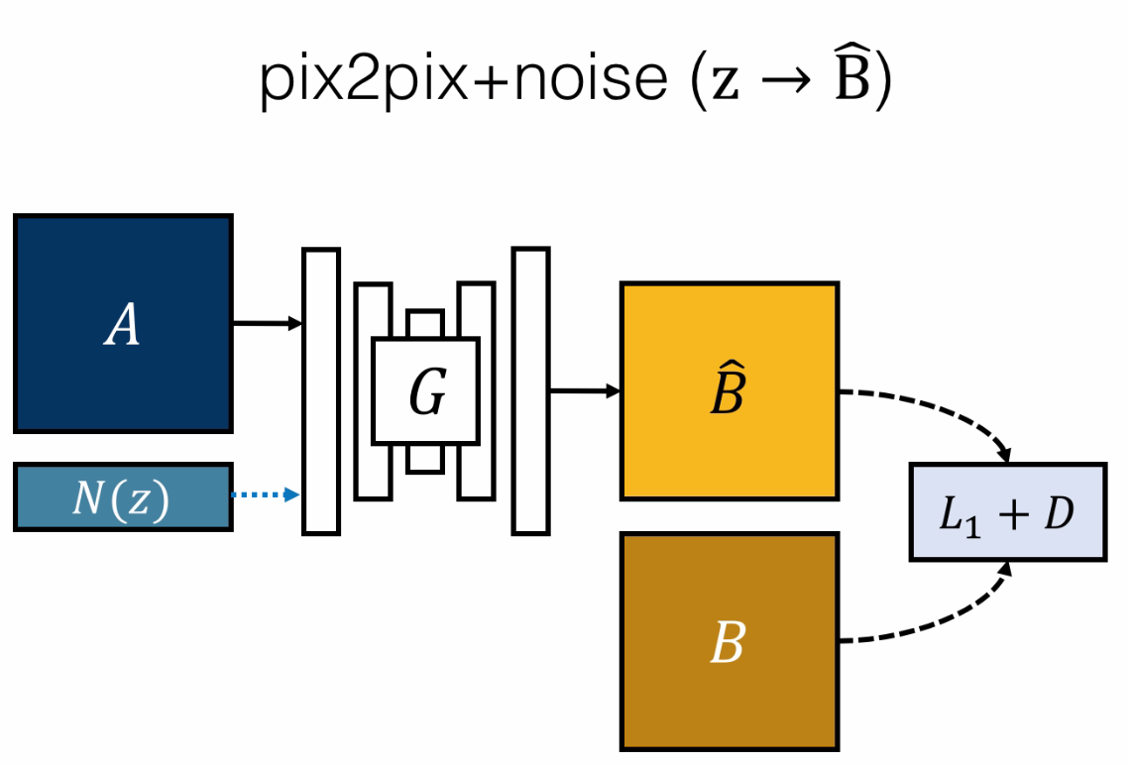
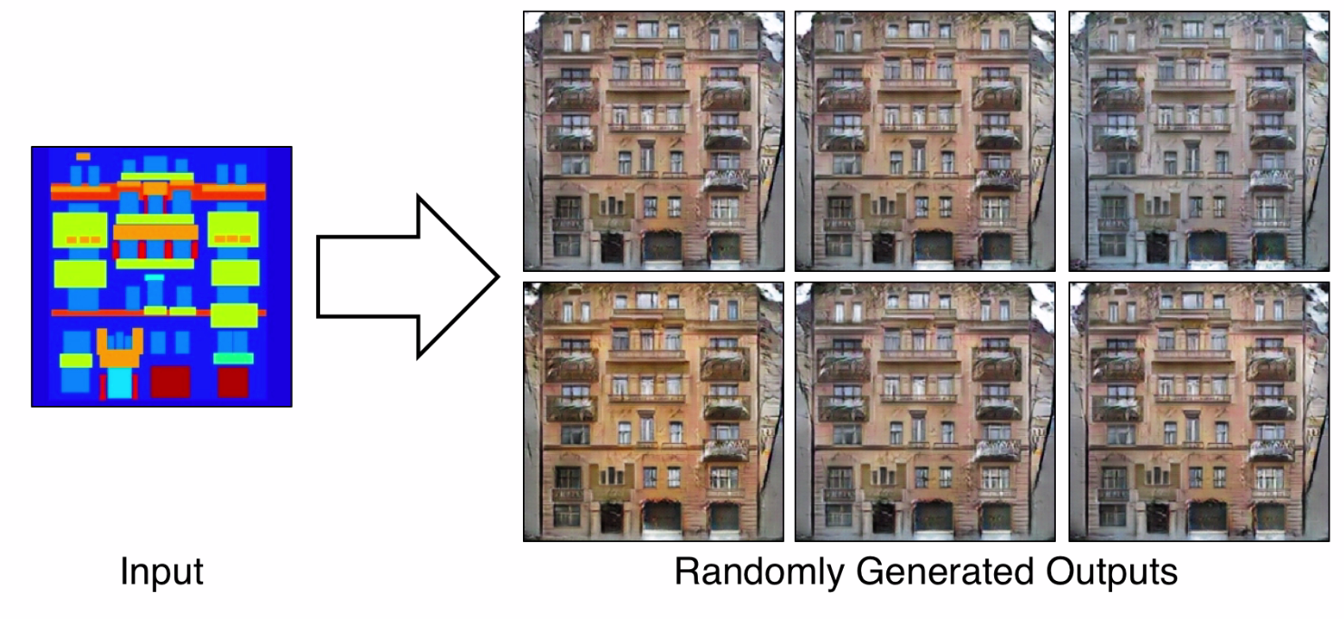
Related work
…
Low variation due to mode collapse

Slide 13
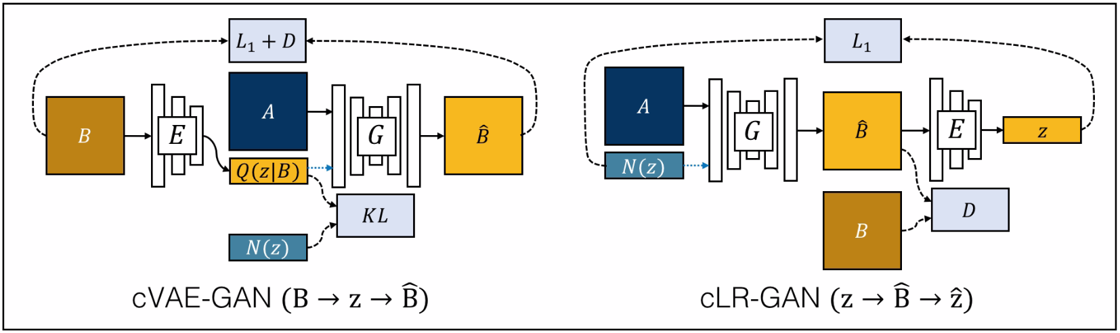
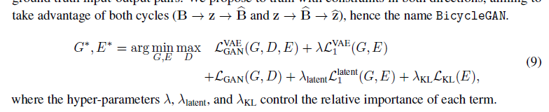
Related work
BicycleGAN

Slide 14
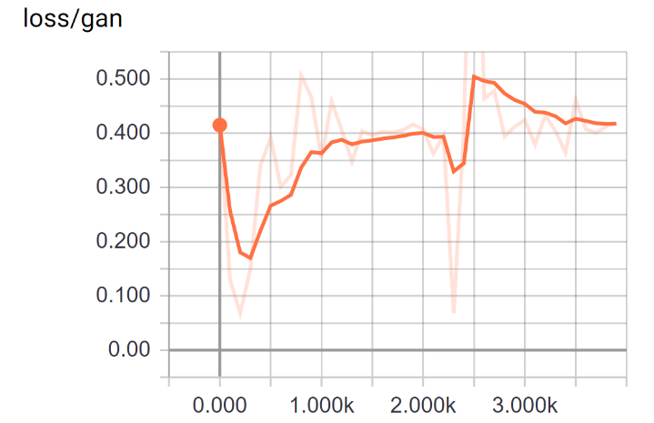
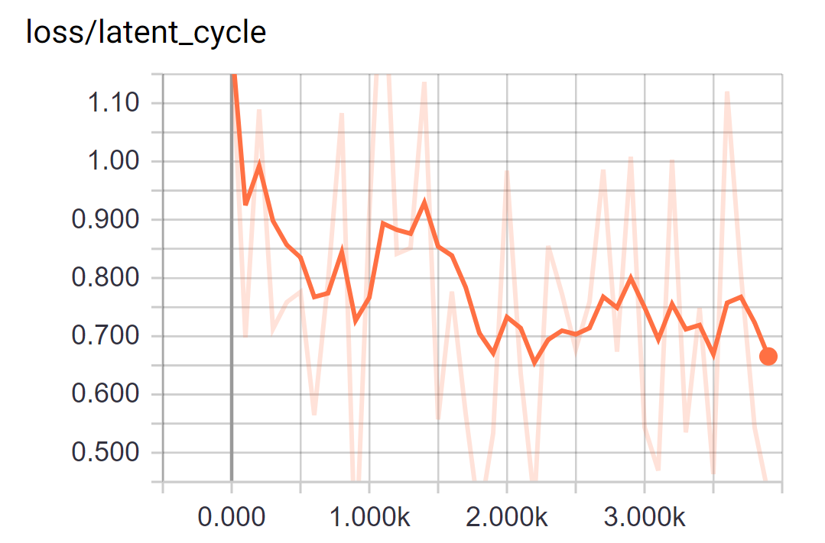
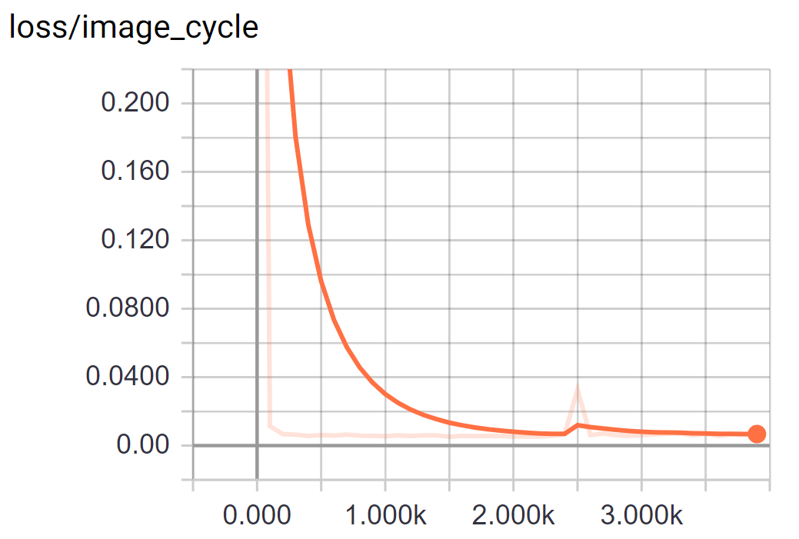
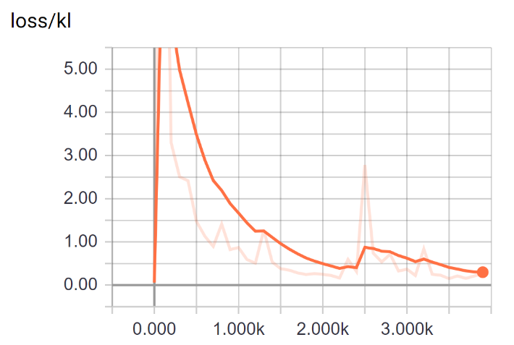
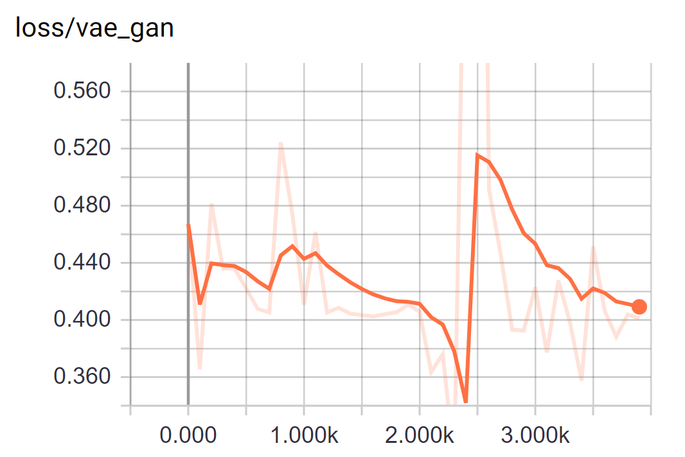
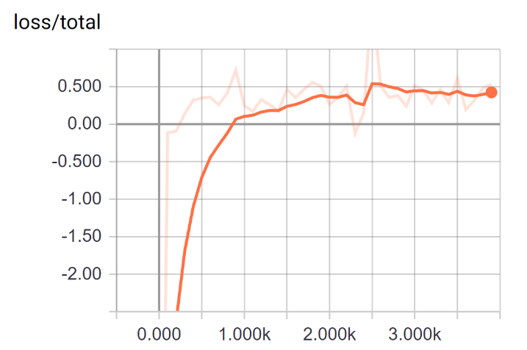
Implementation details
Pytorch using pre-trained models & TensorFlow for training one:

Slide 15
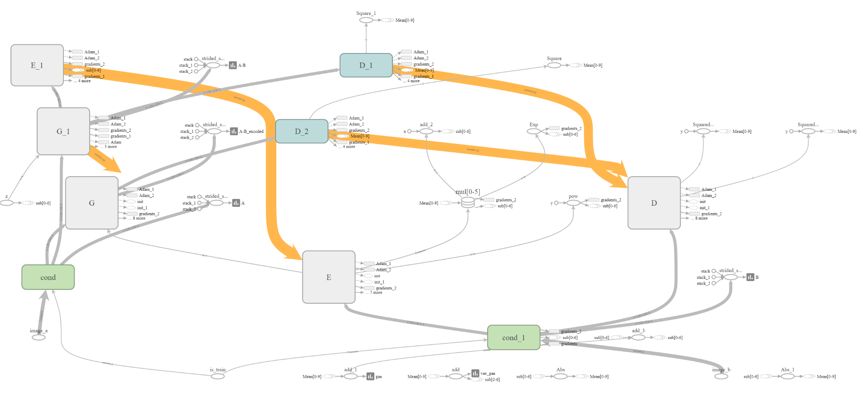
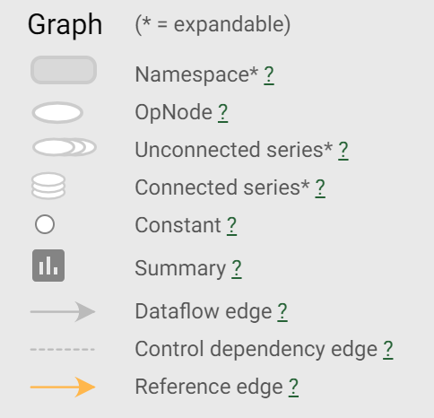
Implementation details

Slide 16
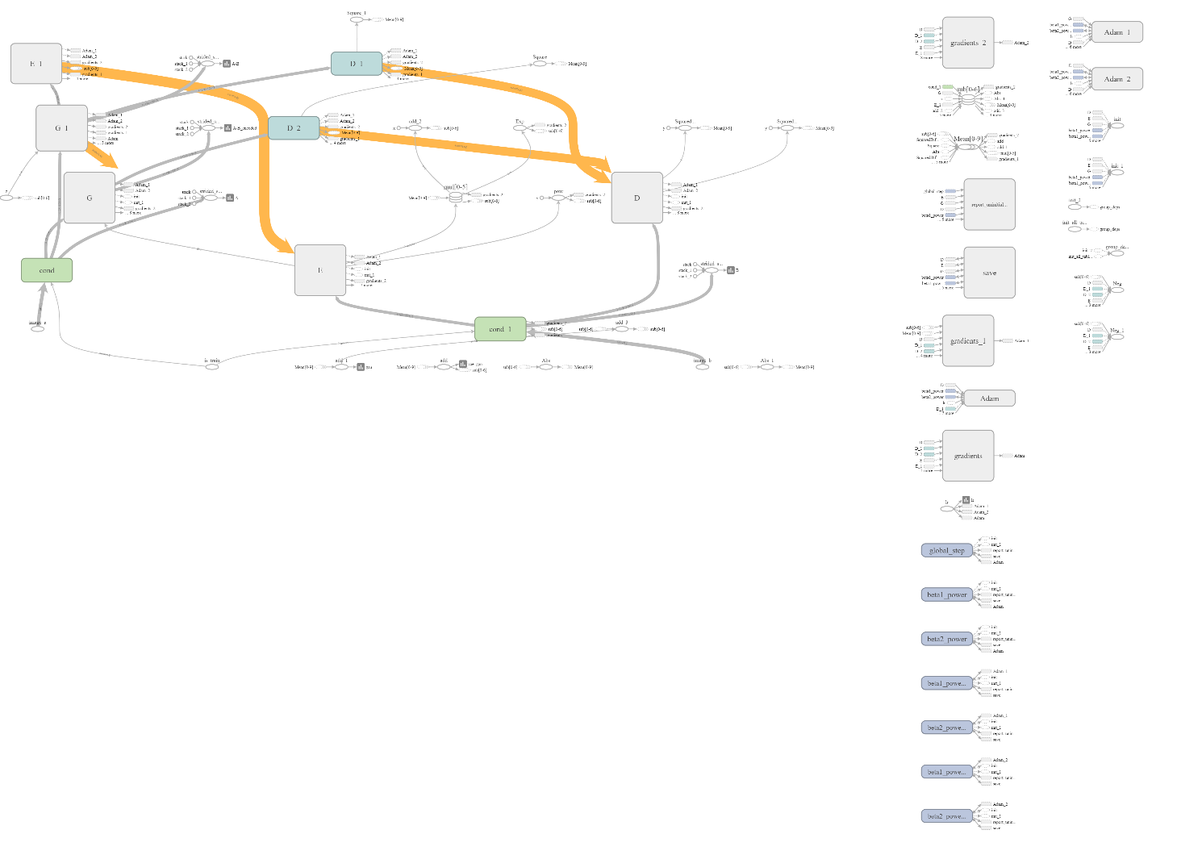


Slide 17
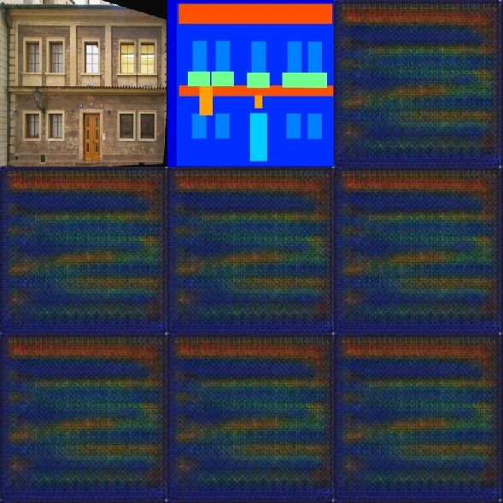
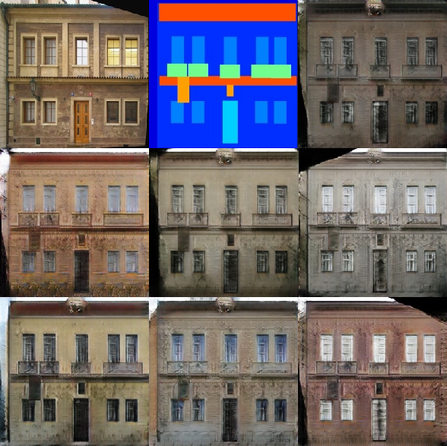
Implementation details
Difficulties …
First results
Later

Slide 18
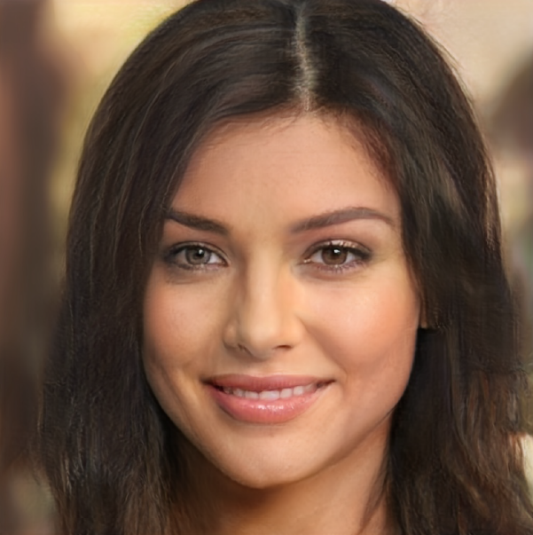
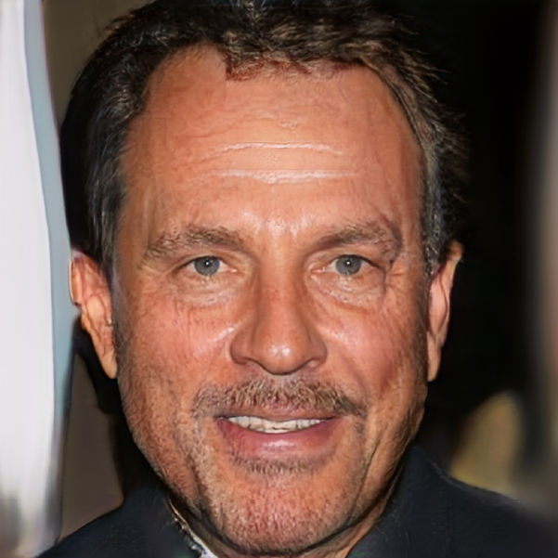
More applications
Progressively growing GANs to generate faces of celebrities:
Good

Slide 19
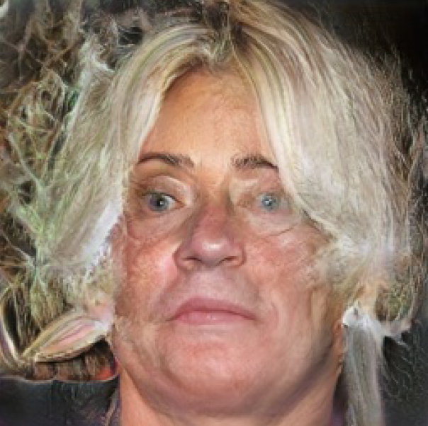
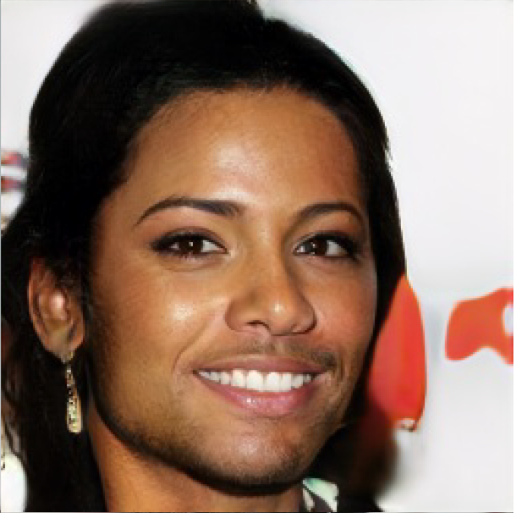
More applications
Progressively growing GANs to generate faces of celebrities:
Not so good …

Slide 20
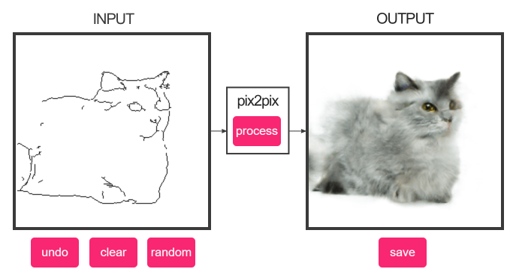

More applications
Edged2Cats tool:
Cycle GANs:

Slide 21
Sources
Generative Adversarial Networks (GANs):
[1] | I. J. Goodfellow, J. Pouget-Abadie, M. Mirza, B. Xu, D. Warde-Farley, S. Ozair, A. Courville, Y. Bengio, “Generative Adversarial Networks”, eprint, 2014, arXiv: 1406.2661
Pix2pix (GAN in conditional setting & noise):
[2] | P. Isola, J. Y. Zhu, T. Zhou and A. A. Efros, "Image-to-Image Translation with Conditional Adversarial Networks", 2017 IEEE Conference on Computer Vision and Pattern Recognition (CVPR), Honolulu, HI, 2017, arXiv: 1611.07004, GitHub: https://github.com/junyanz/pytorch-CycleGAN-and-pix2pix
BicycleGAN (GAN with prevention of mode collapse):
[3] | J.Y. Zhu, R. Zhang, D. Pathak, T. Darrell, A. A. Efros, O. Wang, E. Shechtman, “Toward Multimodal Image-to-Image Translation”, 2017 in NIPS, 2017, arXiv: 1711.11586, GitHub: https://github.com/junyanz/BicycleGAN
CycleGAN (GAN with cycle consistency loss):
[4] | Jun-Yan Zhu, Taesung Park, Phillip Isola, and Alexei A. Efros. "Unpaired Image-to-Image Translation using Cycle-Consistent Adversarial Networks", in IEEE International Conference on Computer Vision (ICCV), 2017, arXiv:1703.10593, GitHub: https://github.com/junyanz/pytorch-CycleGAN-and-pix2pix
Progressive growing of GANs:
[5] | T. Karras, T. Aila, S. Laine, J. Lehtinen, “Progressive Growing of GANs for Improved Quality, Stability, and Variation”, 2018 ICLR Conference on Learning Representations, Vancouver, 2017, arXiv: 1710.10196, GitHub: https://github.com/tkarras/progressive_growing_of_gans

Slide 22
Work distribution
The work was distributed as follows:
Philipp
Ganiyu

Slide 23

Discussion
Any Questions?

